Slide 1
Entrepreneurship BS-CS – 2022 – Spring Semester
Salmaan Rahman
Lecture 6
The Marketing Plan

Slide 2
The marketing Plan
A written statement of marketing objectives, strategies and activities to be followed in order to introduce your product/service to new customers
Every marketing plan begins with industry analysis
Focus is on gathering sufficient information about the national and local environment, and on competitors
Information is gathered through:
Primary sources: specific information about products, services, prices
Marketing research on customers – pricing etc.
Secondary sources – industry publications, internet
Purpose is to determine:
The most effective market position
Set market goals and objectives
Determine which strategies will help achieve those goals.

Slide 3
Market Information Needs The inverted pyramid
General Environmental and Demographic Trends
National Industry Trends
Local Competition (strengths and weaknesses)
Local Environmental and Demographic trends
Local Industry Trends
Goals & Objectives

Slide 4
Direct Marketing Research
Gathering data to determine:
Who will buy the product or use the service
Size of market
Price that can be charged
Appropriate distribution channels
Promotion strategies
Used to inform and reach customers
Techniques:
Focus groups
External consultant
Self

Slide 5
Marketing Research – 4 step approach
Define the purpose and objectives – making a list of the information required.
Is the product needed in the market?
How many people are likely to use the product/service?
How much are they likely to pay?
Where, when, and how are they likely to purchase the product?
Where and how are they likely to hear about the product?

Slide 6
Marketing research -Gathering data
Gather information from secondary resources
Magazines, trade journals, newspapers, libraries, chamber of commerce.
Commercial data – Neilson index, National Market Index – usually expensive.
Internet
Gather information from Primary sources - involves data collecting instruments such as questionnaires etc
Observation - inexpensive
Interview/ survey – phone, mail, or in person
Focus groups – expensive, informal open groups
Experimentation – very expensive
Analyze and Interpret results

Slide 7
Keep in mind:
The marketing plan should serve as a road map to guide the entrepreneur
An annual marketing plan should be prepared before any decisions are made about production, manufacturing, personnel, or financial resources
The marketing plan becomes the basis for planning all the other aspects of the business and for developing budgets for the year

Slide 8
Characteristics of a Marketing Plan
It should provide a strategy for accomplishing the company mission or goal
It should be based on facts and valid assumptions
It must provide for the use of existing resources – allocation of all equipment, financial resources and human resources must be described
Should be simple and short
Must be flexible – changes should be incorporated using “what if” scenarios
Must specify performance criteria used for monitoring and control
E.g. 10% market share in first year in designated geographical area

Slide 9
Information needed:
Customer information:
Who are the users, where they are located, how much will they buy, from whom, and why? (market segmentation)
How do they feel about competitor products?
Advertizing information:
How have promotion and advertizing been used, and which approach is most effective?
Price Information:
How do prices change in each market, and who/what initiates those changes?
Distribution
What channels of distribution will be employed?

Slide 10
Information needed(cont)
Competitor Information:
Who are the competitors,
where are they located, and
what (dis)advantages, do they have?
What marketing techniques have they used, which have been most/least successful
Self information:
What are the overall objectives for the first year
What are the long term objectives (5 years)
What are the company’s strengths and weaknesses?
What are the production capacities,
What are the financial capacities?

Slide 11
Competitor analysis
Document the current strategy of each competitor
Using public information – newspapers, journals, websites, promotions, interviews with distributors and suppliers
Identify strengths and weaknesses of each competitor
Determine strategy for your own product/service

Slide 12
Competitor Assessment Matrix
 | Competitor A | Competitor B | Competitor C
Product or service strategy
Pricing Strategy
Distribution Strategy
Promotion Strategy
Strengths
Weaknesses

Slide 13
Factors that influence the Marketing Plan
External Factors:
Economy
Culture
Technology
Demand
Legal Considerations
Raw Material
Competitors
Internal
Financial Resources
Suppliers
Goals and Objectives
Management Team

Slide 14
Marketing Plan Outline
Situation Analysis
Background of venture – history of industry and company, marketplace
Strengths and weaknesses of venture
Market opportunities and threats
Competitor Analysis
Marketing objectives and goals
Marketing strategy and action programs
Budgets
Controls

Slide 15
Steps in Preparing a Marketing Plan: Step 1
Defining the Business Situation
Essentially a review of situation up to date
Includes the Environmental analysis (external factors)
In new ventures, this part describes how and why the product / service was developed
Should contain information about present market conditions and performance of company goods
Future opportunities and prospects
Must contain a analysis of the industry and competitor environment

Slide 16
Step 2 -
Define the Target market and Opportunities and Threats within the market. Readers should get a good idea about
Who the customer is
Where the customer is
What the target market looks like (size, growth)
Market segments being targeted

Slide 17
Step 3
Strengths and Weaknesses
Strengths: your ability to meet opportunities in the market successfully
Weaknesses – limitations within the company that might prevent you from meeting the opportunities
Strengths and weaknesses also refer to your product/service as compared to competitors
What are the strengths of your products?
What are the weaknesses?

Slide 18
Step 4
Establish Goals and Objectives
Must be realistic and specific
Introduction, penetration, distribution percentages etc.
Goals should be quantifiable
Goals should be limited to key areas – 6-8, ideally

Slide 19
Step 5 – Define Market strategy and Action Programs:
Product and Service description
What makes you unique - differentiation
Core competency
Pricing
Costs
Margins/markups
Competition pricing
Distribution
Channels of distribution
Promotion

Slide 20
Market strategy and Action Programs: (cont)
Budgeting the marketing Strategy
Costs of implementation
Personnel / staff, advertizing, etc.
Implementation
Timeline, process, strategy etc
Monitoring Progress

Slide 21
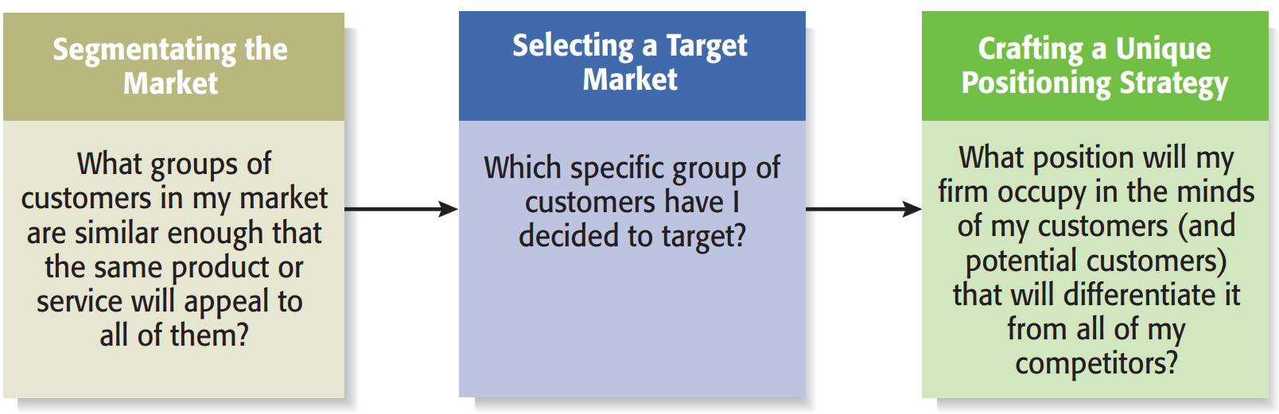
Developing Marketing Strategies

Slide 22
Developing Business Strategies Step 1
Step 1
Identify the most appropriate market by segmenting
Study the industry
Determine the different potential target markets in that industry
Segmenting can be done in many dimensions:
Geography
Demographics (age, gender, family size, income)
Psychographic variables (Personality, lifestyle, values)
Behavior (Product usage, brand preference)
Product type
Customer type (individuals, businesses, schools, government)

Slide 23
Segment characteristics:
People within a segment have a similarity of needs and wants
These are different from other segments
Differences within a segment should be smaller than differences between segments
Segments should be distinct enough that its members can be easily identified
Segment should be large enough to earn profits from
Eg: IBIS segment of the fitness industry
Total size: $26.5 billion
65% gyms and fitness centers
10% other
7% dance centers
7% Swimming pools
6% ice and roller rinks
5% tennis centers

Slide 24
Developing Business Strategies Step 2 – Select Target Market
Selecting the Target market
Initial targets are typically small
Market should be sufficiently attractive
Firm should be able to serve it well – preferably better than competitors
Should be large enough to return sufficient profits to fuel growth
Market should in sync with business model and skills of founders and initial employees

Slide 25
Developing Business Strategies Step 3: Craft a Unique Position
A start-up’s position is defined by its products and services
Its “unique position” is what differentiates it from competitors
Typically: price, service, amenities, quality, experience
Achieving a unique position is what allows a “brand” to develop - Branding

Slide 26
Branding:
Definition: a set of attributes - which may be positive or negative - that customers associate with a company
Positive: trustworthy, innovative, dependable
Negative: cheap, unreliable, difficult to deal with, poor service
Start-ups need to build a brand from scratch (brand management) and maintain it
A brand is the meaning of the company in its customer’s lives: created value

Slide 27
Branding:
Brands are built through
Advertising
Public relations
Sponsorships
support of social causes
Social media
However….good performance is the most important aspect of brand-building
Reliability
Service
Consistency
Reputation
Value
Credibility
A firm’s name, logo, website design, Facebook page, and even its letterhead are part of its brand. It’s important for start-ups, particularly if they plan to sell to other businesses, to have a polished image immediately

Slide 28
Marketing for New Ventures The 4 Ps
Strategies are developed using a marketing mix - a set of controllable tactical marketing tools
The 4 categories are
Product
Price
Promotion
Place

Slide 29
Marketing for New Ventures - The 4 Ps Product:
A firm’s product is the goods or service it offers in the market
Good: something that takes on a physical form (e.g. cell phones)
Service: intangible – an activity or benefit done for the customer
Core product vs. actual product
Core Product: Generic product
Actual product may have as many as five characteristics:
Quality level
Features
Design
brand name
Packaging

Slide 30
Marketing for New Ventures - The 4 Ps 2) Price:
Price is the amount of money consumers pay to buy a product
It is the only element in the marketing mix that generates revenue – all the others are costs
Pricing – setting the price for your product service
Cost-based pricing
Value-based pricing

Slide 31
Pricing:
Cost-based Pricing :
List price is determined by adding a markup percentage to a product’s cost
Markup percentage may be standard for the industry or may be arbitrarily determined by the entrepreneur.
Pros: Straightforward, and easy to justify the price of a good or service.
Cons: Not always easy to estimate what the costs of a product will be.
Once a price is set, it is difficult to raise it, even if a company’s costs increase in an unpredicted manner.
Cost-based pricing is based on what a company thinks it should receive rather than on what the market thinks a good or service is worth (ignores customer imput)

Slide 32
Pricing (cont.)
Value-based Pricing:
List price determined by estimating what consumers are willing to pay for a product and then backing off a bit to provide a cushion.
What a customer is willing to pay is determined by:
Perceived value of the product
Number of choices available in the marketplace
Firms influence customers’ perception of “value” through positioning, branding, and the other elements of the marketing mix.
Most experts recommend value-based pricing
A gross margin (a company’s net sales minus its costs of goods sold) of 60 to 80 percent is not uncommon in high-tech industries.
Most experts also warn entrepreneurs to resist the temptation to charge a low price for their products in the hopes of capturing market share. This approach can win a sale but generates little profit.

Slide 33
Marketing for New Ventures - The 4 Ps 3) Promotion:
Promotion: activities the firm takes to communicate the merits of its product to its target market.
The goal of these activities is to persuade people to buy the product.
Start-ups have limited resources so they must carefully study promotion activities before choosing the one or ones they’ll use.
Types of Promotion
Advertizing
Public Relations
Social Media presence
Promotion related activities
Viral Marketing
Guerrilla marketing

Slide 34
Promotion - Advertizing:
Advertising: making people aware of a product in hopes of persuading them to buy
Advertising goals:
Raise customer awareness of a product
Explain a product’s comparative features and benefits
Create associations between a product and a certain lifestyle
Channels:
Direct mail
Print media – magazines, newspapers
Radio, television
Billboards
Internet: blogs, social media, search engines.

Slide 35
Promotion Advertizing (cont):
Weaknesses:
Low credibility
High percentage of the people who see an ad will not be interested
Message clutter - people simply tune out
Relative costliness compared to other forms of promotions
The perception that advertising is intrusive
Because of these weaknesses, most start-ups do not utilize advertizing broadly
Choose selectively: blogs, trade journals, pay-per-click
Hybrid promotional campaigns

Slide 36
Promotion - Advertizing: Online advertizing:
Pay-per-click advertising provided by online search engines
Highly targeted
Used by firms of all sizes
Google: 2 programs—AdWords and AdSense
Yahoo and Microsoft - joint program - Yahoo Bing Network.
Creating your own:
Creating a website (dedicated website, blog, Social media page) etc
Typically carries articles, tips, videos, useful information

Slide 37
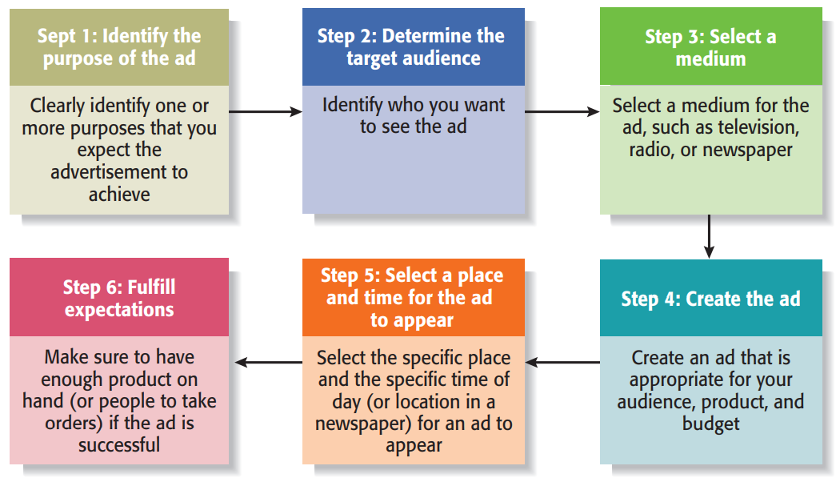
Promotion - Advertizing (cont): Steps:

Slide 38
Promotion: Public Relations
Public relations: The efforts to establish and maintain a company’s image with the public.
Major difference between public relations and advertising is that public relations is not paid for directly.
The cost of public relations lies in effort:
Networking with journalists, blog authors, and other people to try to interest them
Press Releases
Media Coverage
Social Media Presence
Articles in trade publications
Blogging
Newsletter
Civic, Social and Community involvement

Slide 39
Promotion: Public Relations
Press kit:
Folder containing information about the company
List of accomplishments
Available at all times to journalists, other companies, and online
Trade Shows:
Establishing a presence in tradeshows has be balanced against cost
Ideal for
businesses catering to other businesses
Suppliers and distributors
Networking
Customer outreach and interaction
Social Media
Blogging, Facebook, Twitter etc.
Connecting with customers – answering questions, giveaways, contests etc.
Answering questions

Slide 40
Promotion: Other activities:
Free Sample distribution
Useful for some companies that sell in bulk
Pharmaceutical companies
Free Trial periods
Useful for IT products, fitness clubs etc.
Viral Marketing
Creating a marketing message and encouraging people to pass it along
Depends on pass-along rate
Guerrilla Marketing: Relies on ingenuity, surprise and cleverness

Slide 41
Marketing for New Ventures - The 4 Ps 4) Place (distribution)
Place, or distribution: all the activities that move a firm’s product from its place of origin to the consumer.
Distribution channel is the route a product takes from the place it is made to the customer who is the end user
Categories:
Direct selling – most common
Intermediaries – through retailers, distributors, etc.

Slide 42
Placement
Direct Selling:
Pros: control of process
Cons:
Capital tied up in outlets
Sales team requires customer interface – shop, online, etc
Need to find customers yourself

Slide 43
Placement
Selling through intermediaries: Distributors, wholesalers etc.
Pros:
Do not need to own the distribution channel
Cons:
Loss of control of product
Lower revenues

